Slide 1



AI-Based Orange Quality Detection for Export
Revolutionizing orange quality inspection for the global market.
by
1)Balavasanth R
2)Kaushik Kumar
3)Ritesh S
4)Sanjith M
5)Dinesh Raj N

Slide 2
Objective: Streamlining Export Quality
AI-Driven System
Seamless Integration
Automated Sorting
Real-time fruit quality detection
Packing line efficiency and accuracy
Export quality vs. non-export

Slide 3
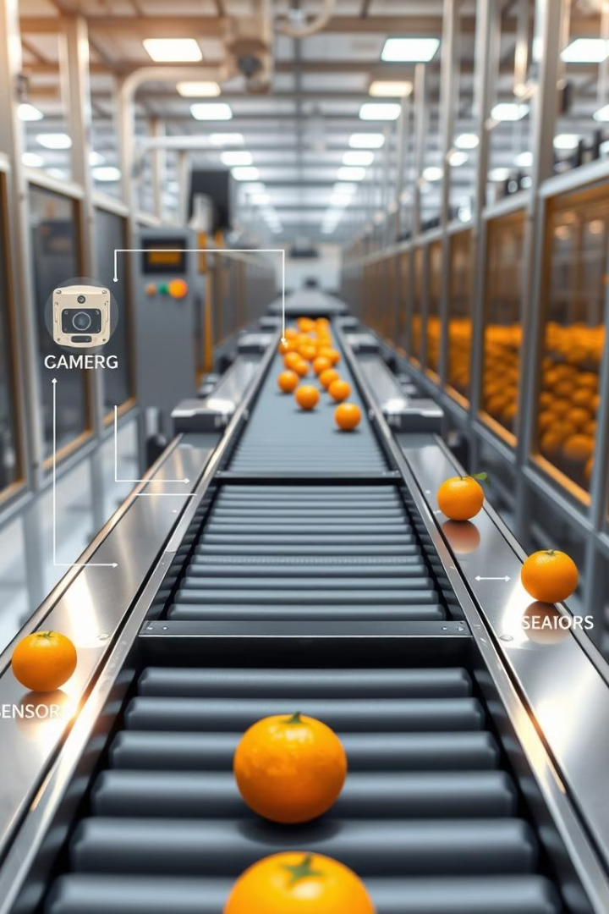
AI-Powered Solution: A Multi-Layered Approach
1
YOLO(You Only Look Once)-based AI model identifies physical defects
2
Conveyor belt with automated gating mechanism
3
Quality assessment sensors analyze internal properties
4
Linear regression model for final sorting decision

Slide 4
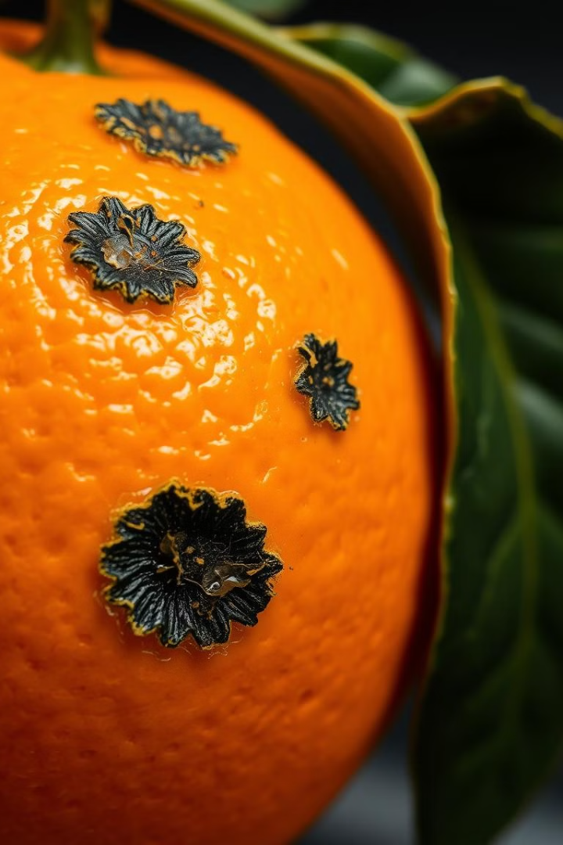
Defect Detection: Identifying Imperfections
Objective
Identify fungal growth, bruises, cuts, and other physical defects
Method
Image capture via cameras
Real-time Processing
YOLO-based deep learning model
Rejection
Defective fruits rejected via gating system

Slide 5
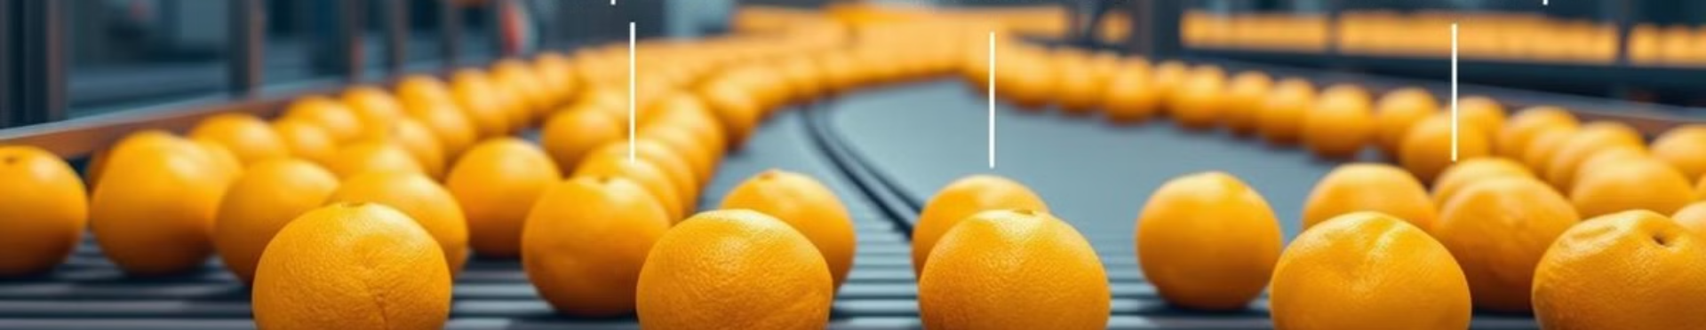



Quality Assessment: Internal Property Analysis
Ultrasonic Sensor measures firmness (squishiness)
Gas Sensors detect ethylene gas (ripeness)
Infrared Sensor estimates sugar content (sweetness)

Slide 6
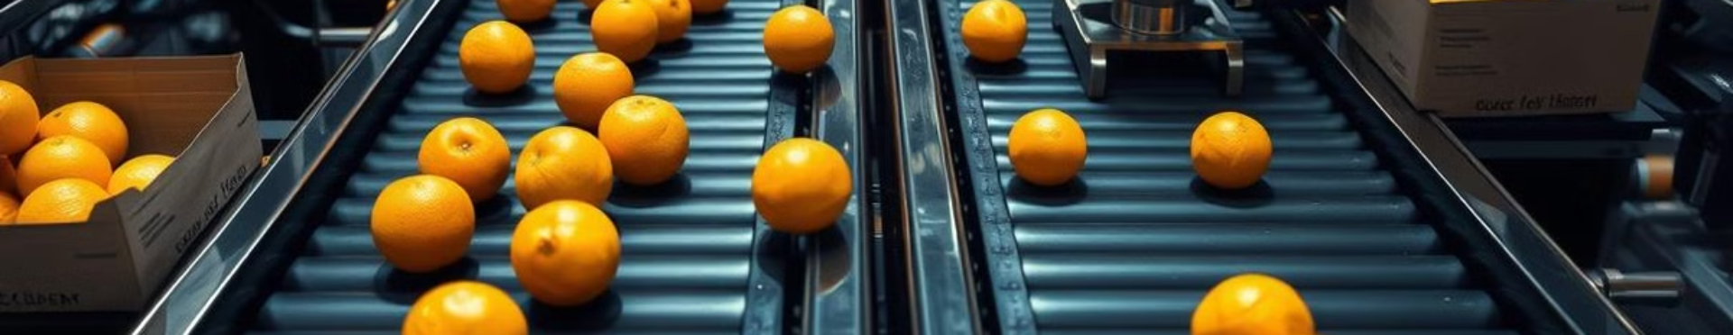




Decision Making: Sorting and Export
Good Quality
Export-Grade
Low Quality
Rejected
Meets all quality parameters
Sent for export
Does not meet quality parameters
Diverted for local use or processing

Slide 7
Workflow: Seamless Integration
Camera Captures Orange Image
1
2
YOLO Model Detects Defects
Defective Oranges Rejected
3
4
Good Oranges Pass to Sensor Layer
Sensor Data Processed
5
6
Final Decision Made
Export-Quality Oranges Sorted
7

Slide 8
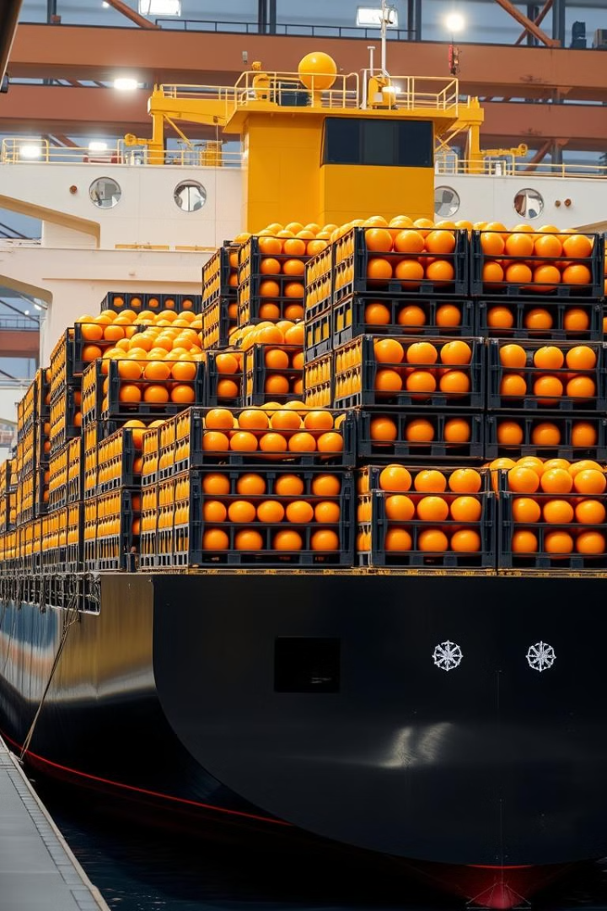
Impact: Advantages of AI-Based Inspection
1
Faster Inspection
More efficient than manual methods
2
Reduced Error
Increased efficiency and accuracy
3
Improved Compliance
Ensures meeting export standards
4
Minimized Losses
Reduces defective fruit in shipments

Slide 9
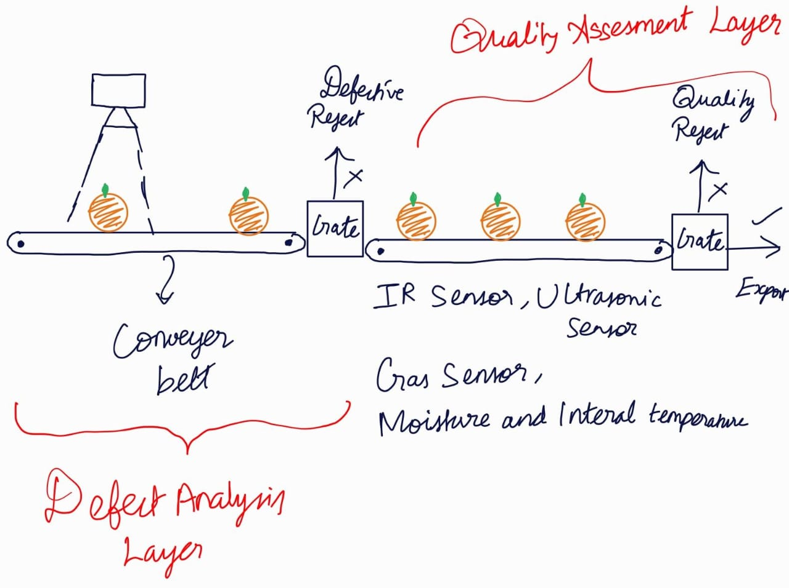
Sample Model Design

Slide 10
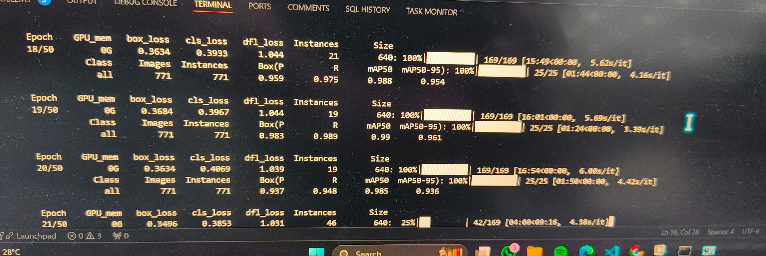
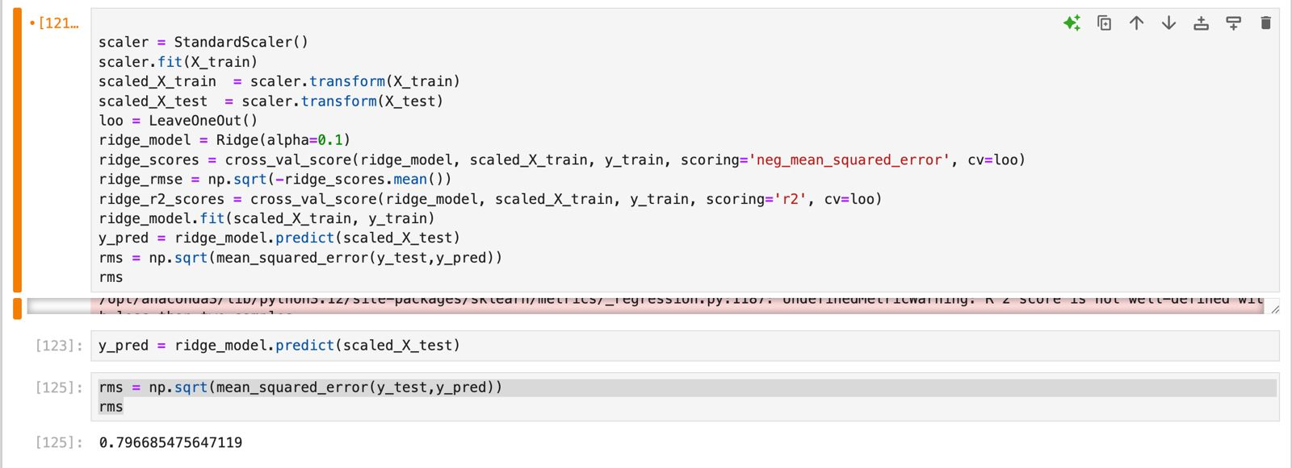
Development Progress

